Slide 1
Unit-IV Bayesian Networks
Unit-IV Bayesian Networks 04 Hours
Contents
Introduction of Bayesian Nets, Bayesian Networks- Directed Acyclic Graphs, Bayesian Networks and Proof of Theorem, Bipartite Multiple-Diagnosis Problems, Singly Connected DAGs, Deduction, Abduction, and Induction, Multiple Diagnosis in Bipartite Networks, Irredundant Covers, An Algorithm for Singly Connected Networks, Some Theorems and Proofs - Two Theorems, Formulas for PI and Lambda, Certainty Factors, What Are Certainty Factors?, An Interpretation of Certainty Factors, Limits on Certainty

Slide 2
Uncertainty
Agents may need to handle uncertainty, whether due to partial observability, nondeterminism, or a combination of the two.
An agent may never know for certain what state it’s in or where it will end up after a sequence of actions.
We have seen problem-solving agents and logical agents designed to handle uncertainty by keeping track of a belief state—a representation of the set of all possible world states that it might be in—and generating a contingency plan that handles every possible eventuality that its sensors may report during execution.
Despite its many virtues, however, this approach has significant drawbacks when taken literally as a recipe for creating agent programs:
When interpreting partial sensor information, a logical agent must consider every logically possible explanation for the observations, no matter how unlikely. This leads to impossible large and complex belief-state representations.
A correct contingent plan that handles every eventuality can grow arbitrarily large and must consider arbitrarily unlikely contingencies.
Sometimes there is no plan that is guaranteed to achieve the goal—yet the agent must act. It must have some way to compare the merits of plans that are not guaranteed.
Notes:
Uncertainty in AI signifies a lack of perfect information or a situation where the outcome is not fully known or predictable.
AI agents are software systems that use AI to pursue goals and complete tasks on behalf of users.

Slide 3
Decision Theory
The agent’s knowledge can at best provide only a degree of belief in the relevant sentences.
The main tool for dealing with degrees of belief is probability theory.
To make the choices among different plans /belief states, an agent must first have preferences between the different possible outcomes of the various plans.
We use utility theory to represent and reason with preferences. Utility theory says that every state has a degree of usefulness, or utility, to an agent and that the agent will prefer states with higher utility.
Preferences, as expressed by utilities, are combined with probabilities in the general theory of rational decisions called decision theory:
Decision theory = probability theory + utility theory .
The fundamental idea of decision theory is that an agent is rational if and only if it chooses the action that yields the highest expected utility, averaged over all the possible outcomes of the action. This is called the principle of maximum expected utility (MEU).
The decision-theoretic agent’s belief state represents not just the possibilities for world states but also their probabilities. Given the belief state, the agent can make probabilistic predictions of action outcomes and hence select the action with highest expected utility.

Slide 4
Basics of Probability
Sources:
Kenneth Rosen, Discrete Mathematics and its Applications, Tata McGraw Hill Publication, 7th edition, ISBN 978-0-07-338309-5
Stuart Russell & Peter Norvig, "Artificial Intelligence : A Modern Approach", Pearson Education, 2nd Edition.
Edward A. Bender, Mathematical Methods in Artificial Intelligence, IEEE Computer Society Press Los Alamitos, California, ISBN: 9780818672002, 9780818672002.
https://www.maths.tcd.ie/~ngarron/MA22S6/bayes.pdf.

Slide 5
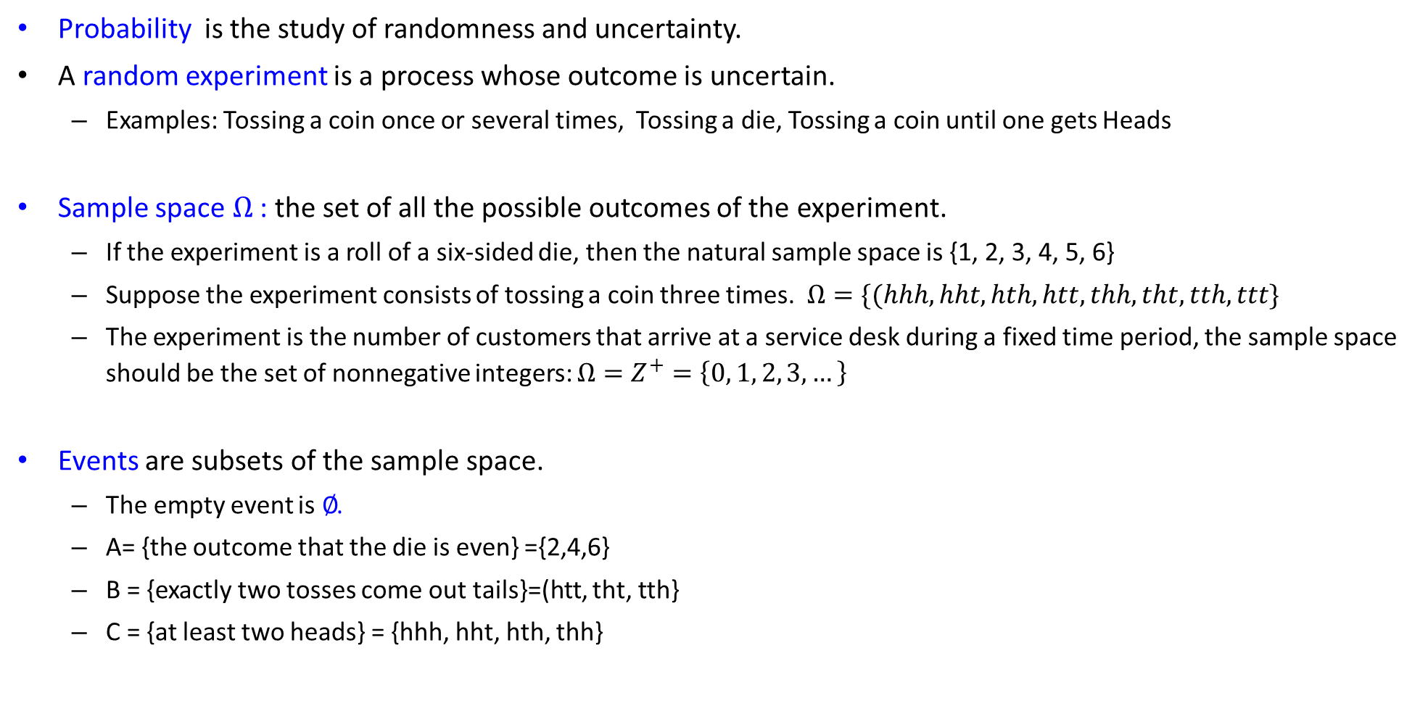
Basics of Probability (1)
Probability is the study of randomness and uncertainty.
A random experiment is a process whose outcome is uncertain.
Examples: Tossing a coin once or several times, Tossing a die, Tossing a coin until one gets Heads
Sample space $Ω$ : the set of all the possible outcomes of the experiment.
If the experiment is a roll of a six-sided die, then the natural sample space is {1, 2, 3, 4, 5, 6}
Suppose the experiment consists of tossing a coin three times. $Ω=\{(hhh, hht, hth, htt, thh, tht, tth, ttt\}$
The experiment is the number of customers that arrive at a service desk during a fixed time period, the sample space should be the set of nonnegative integers: $Ω=Z^{+}=\left\{0, 1, 2, 3, …\right\}$
Events are subsets of the sample space.
The empty event is ∅.
A= {the outcome that the die is even} ={2,4,6}
B = {exactly two tosses come out tails}=(htt, tht, tth}
C = {at least two heads} = {hhh, hht, hth, thh}

Slide 6
Basics of Probability (2)
A Probability is a number assigned to each event in the sample space.
Axioms of Probability:
For any event A, 0 ≤ P(A) ≤ 1. The probability of an event can never be negative or more than one!
The Probability of the entire sample space is P(Ω) = 1.
The Probability of the empty event is P(∅) = 0.
If A₁, A₂, … A_{n} is a partition of A, then P(A) = P(A₁) + P(A₂) + ...+ P(A_{n})
Unconditional or prior probabilities or priors refer to degrees of belief in propositions in the absence of any other information.
Most of the time, however, we have some information, usually called evidence, that has already been revealed.
E.g., the first die may already be showing a 6 and we are waiting with for the doublet. In that case, we are interested not in the unconditional probability of rolling doubles, but the conditional or posterior probability or posterior of rolling doubles given that the first die is a 6. This probability is written P(doubles |Die1 =6), where the “ | ” is pronounced “given.”

Slide 7
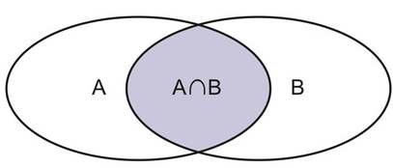
Basics of Probability (3)
Properties of Probability:
For any event A, P(A^{c}) = 1 - P(A).
If A ⊂ B, then P(A) ≤ P(B).
Addition Theorem or Probability of a Disjunction or Inclusion–Exclusion Principle:
The probability of event A or event B can be found by adding the probability of the separate events A and B and subtracting any intersection of the two events.
For any two events A and B, P(A ∪ B) = P (A or B) = P(A) + P(B) - P(A ∩ B).
More intuitively, if we were to take the area of the Venn Diagram below, we would add the areas of figures A and B, and subtract out one overlap’s worth of area, which represents the intersection of A and B.
If A and B two disjoint events A ∩ B = ∅ then P(A ∪ B) = P(A) + P(B).
For three events, A, B, and C, P(A ∪ B ∪ C) = P(A) + P(B) + P(C) - P(A ∩ B) - P(A ∩ C) - P(B ∩ C) + P(A ∩ B ∩ C).
Multiplication Theorem:
This theorem states that if two events A and B are independent then the probability that both of them will occur is equal to the product of their individual probabilities.
For any two independent events A and B P(A ∩ B) = P (A and B) = P(A) × P(B).

Slide 8
Basics of Probability (3)
Conditional Probability:
It appears when partial information about outcome is given.
E.g. On rolling a fair die Q : What is the probability that the outcome is 4 ? Answer: 1/6.
What happens if we know that the outcome is even ?
Q: What is the probability that the outcome is 4 given that the outcome is even?
Answer:
The probability of event B occurring, given that event A has occurred is equal to the probability of event A and B occurring divided by the probability of event A occurring. Events A and B are dependent events.
Multiplication Theorem or Product Rule of Probability for Dependent Events:
The probability of simultaneous happening of two events A and B is given by:
P(A ∩ B) = P(A) × P(B|A) ; P(A) ≠ 0
P(A ∩ B) = P(B) × P(A|B) ; P(B) ≠ 0
where P (B|A) is the conditional probability of happening of B under the condition that A has happened, and P (A|B) is the conditional probability of happening of A under the condition that B has happened.
P(B|A) = ^{P(A ∩ B)} ; if P(A) ≠ 0
^{P(A)}

Slide 9
Basics of Probability (4)
Q.1. An urn contains four blue balls and five red balls. What is the probability that a ball chosen at random from the urn is blue?
Q.2. What is the probability that when two dice are rolled, the sum of the numbers on the two dice is 7?
Answer: To calculate the probability, note that there are nine possible outcomes, and four of these possible outcomes produce a blue ball. Hence, the probability that a blue ball is chosen is 4/9.
Answer: There are a total of 36 equally likely possible outcomes when two dice are rolled.
(The product rule can be used to see this; because each die has six possible outcomes, the total number of outcomes when two dice are rolled is 6² = 36.)
There are six successful outcomes so that the sum of the numbers on the two dice is 7, namely, (1, 6), (2, 5), (3, 4), (4, 3), (5, 2), and (6, 1), where the values of the first and second dice are represented by an ordered pair. Hence, the probability that a seven comes up when two fair dice are rolled is 6/36 = 1/6.

Slide 10
Basics of Probability (5)
Q.3. From a pack of 52 cards, two cards are drawn at random one after the other with replacement. What is the probability that both cards are kings?
Q.4. A card is drawn from a pack of 52 cards. Find the probability that drawn card is either a diamond or an ace of club.
Answer: The probability of drawing a king P (A) = 4/52
The probability of drawing again the king after replacement P (B) = 4/52
Since the two events are independent, the probability of drawing two kings is:
P(A ∩ B) = P (A and B) = P(A) × P(B) = 4/52 × 4/52 =1/169.
Answer: The probability of drawing a card of diamond P(A) = 13/52.
The probability of drawing an ace of club P(B) = 1/52.
Since the events are mutually exclusive, probability of drawing a card being a diamond or an ace of
club is: P(A∪B)= P(A) + P(B) = 13/52+1/52=14/52= 7/26.

Slide 11
Basics of Probability (6)
Q.5. A bag contains 4 red balls, 3 white balls and 5 black balls. Two balls are drawn one after the other with replacement. Find the probability that first is red and the second is black.
Q.6. A card is drawn at random from a pack of 52 cards. Find the probability that the drawn card is either club or a queen.
Answer: The probability of red ball in the first draw P(R)= 4/12.
The probability of a black ball in the second draw P(B)= 5/12.
Since the events are independent, the probability that first is red and the second are black will be:
P(R ∩ B) = P (R and B) = P(R) × P(B) = 4/12 × 5/12 = 20/144 =10/72 = 5/36.
Answer: The probability of drawing a card of club P(A) = 13/52.
The probability of drawing a queen card P(B) = 4/52.
As, one of the queen is club, so, the events are not mutually exclusive.
So, the probability of drawing queen of club = P(A∩B)=1/52
P(A∪B) = P(A) + P(B) − P(A∩B)
= 13/52 + 4/52 − 1/52
= 16/52 = 4/13

Slide 12
Basics of Probability (7)
Q.7. A bag contains 5 white and 8 red balls. Two successive drawings of 3 balls are made such that (a) the balls are replaced before the second drawing, and (b) the balls are not replaced before the second draw. Find the probability that the first drawing will give 3 white and the second 3 red balls in each case.
Answer: (a) When balls are replaced.
Total balls in the bag = 8 + 5 = 13
3 balls can be drawn out of total of 13 balls in ¹³C₃ ways.
3 white balls can be drawn out of 5 white balls in ⁵C₃ ways.
Probability of 3 white balls = P(W3) = ⁵C₃ / ¹³C₃ = 5/143.
Since the balls are replaced after the first draw so again there are 13 balls in the bag.
3 balls can be drawn out of total of 13 balls in ¹³C₃ ways.
3 red balls can be drawn out of 8 red balls in ⁸C₃ ways.
Probability of 3 red balls = P(R3) = ⁸C₃ / ¹³C₃ = 28/143.
Since the events are independent, the required probability is:
P(W3 ∩ R3) = P(W3) × P(R3) = (⁵C₃ / ¹³C₃ ) × (⁸C₃ / ¹³C₃ )
= (5/143) × (28/143 ) = 140/20,449

Slide 13
Basics of Probability (8)
Q.7. cont..
Answer:
(b) When the balls are not replaced before second draw
Total balls in the bag = 8 + 5 = 13
3 balls can be drawn out of total of 13 balls in ¹³C₃ ways.
3 white balls can be drawn out of 5 white balls in ⁵C₃ ways.
The probability of drawing 3 white balls = P(W3) = ⁵C₃ / ¹³C₃ = 5/143.
After the first draw, balls left are 10, 3 balls can be drawn out of 10 balls in ¹⁰C₃ ways.
3 red balls can be drawn out of 8 balls in ⁸C₃ ways.
Probability of 3 red balls = P(R3) = ⁸C₃ / ¹⁰C₃ = 56/286.
Since the events are independent, the required probability is:
P(W3 ∩ R3) = P(W3) × P(R3) = (⁵C₃ / ¹³C₃ ) × (⁸C₃ / ¹⁰C₃ )
= (5/143) × (7/15 ) = 7/429

Slide 14
Basics of Probability (9)
Q.8. Two dice are rolled together. Find the probability of getting a doublet or sum of faces as 4.
Q.9. Find the probability of drawing a diamond card in each of the two consecutive draws from a well-shuffled pack of cards, if the card drawn is not replaced after the first draw.
Answer: When two dice are rolled together, there will be 6×6 = 36 outcomes. Let S be the sample space. Then n(S) = 36.
Then the event of getting a doublet = A = {(1,1),(2,2),(3,3),(4,4),(5,5),(6,6)}. So, n (A) = 6.
The event of getting face sum 4 = B = {(1,3),(2,2),(3,1)}. So, n (B) = 3.
Therefore, A Ո B = {(2,2)}. So, n (A ∩ B) = 1.
Therefore, P (getting a doublet or a total of 4) = P (A U B) = P (A) + P (B ) − P (A ∩ B)
= 6/36 + 3/36 – 1/36 = 8/36 = 2/9.
Answer: The probability of the event of drawing a diamond card in the first draw P(A) = ¹³C₁ / ⁵² C₁ = 13/52 = 1/4
After drawing a diamond card in the first draw 51 cards are left out of which 12 cards are diamond cards.
∴ Probability of drawing a diamond card in the second draw when a diamond card has already been drawn in the first draw = P(B|A) = ₁₂C₁ / ₅₁C₁ = 12/51 = 4/17
∴ Required probability = P(A ∩ B) = P(A) × P(B|A) = 1/4 × 4/17 = 1/17

Slide 15
Basics of Probability (10)
Q.10. A card is drawn from a pack of 52 cards. Find the probability of getting a king or a heart or a red card.
Answer: The probability of event of getting a king card P(K) = 4/52.
The probability of the event of getting a heart card P(H) = 13/52.
The probability of the event of getting a red card P(R) = 26/52
P (K Ո H) = P (getting heart king) = 1/52
P (H Ո R) = P (getting red and heart)) = 13/52
P (K Ո R) = P (getting red king) = 2/52
P (K Ո H Ո R) = P (getting heart, king which is red) = 1/52
Therefore, required probability is
P (K U H U R) = P (K) + P (H) + P (R) − P (K Ո H) − P(H Ո R) − P (K Ո R) + P(K Ո H Ո R)
= 4/52 + 13/52 + 26/52 – 1/52 – 13/52 – 2/52 + 1/52 = 28/52 = 7/13.

Slide 16
Basics of Probability (11)
Q.11. It is 8:5 against the wife who is 40 years old living till she is 70 and 4:3 against her husband now 50 living till he is 80. Find the probability that
(i) Both will be alive,
(ii) None will be alive,
(iii) Only wife will be alive,
(iv) Only husband will be alive.
Answer: Let us define the events: A: Wife will be alive, B: Husband will be alive.
Then, we are given: P(A) = 5/(8 + 5) = 5/13 ⇒ P(A’) = 1 – P(A) = 8/13
P(B) = 3/(4 + 3) = 3/7 ⇒ P(B’) = 1 – P(B) = 4/7
If we assume that A and B are independent so that A and B’, A’ and B’ are also independent , then the required probabilities are given by:
P(Both will be alive ) = P(A ∩ B) = P(A) × P(B) = (5/13) × (3/7) = 15/91
(ii) P(None will be alive ) = P(A’ ∩ B’) = P(A’) × P(B’) = (8/13) × (4/7) = 32/91
(iii) P(Only wife will be alive ) = P(A ∩ B’) = P(A) – P(A ∩ B) = (5/13) – (15/91) = 20/91
(iv) P(Only husband will be alive ) = P(A’ ∩ B) = P(B) – P(A ∩ B) = (3/7) – (15/91) = 24/91

Slide 17
Basics of Probability (12)
Q.12. A bag contains 19 tickets, numbered from 1 to 19. A ticket is drawn and then another ticket is drawn without replacement. Find the probability that both tickets will show even numbers.
Answer: Let A be the event of drawing an even numbered ticket in the first draw and B be the event of drawing an even numbered ticket in the second draw.
Then, Required probability = P(A ∩ B) = P(A) × P(B|A) … (i)
Since there are 19 tickets, numbered 1 to 19, in the bag out of which 9 are even numbered viz. 2, 4, 6, 8, 10, 12, 14, 16, 18.
∴ P(A) = 9/19
Since the ticket drawn in the first draw is not replaced, therefore second ticket drawn is from the remaining 18 tickets, out of which 8 are even numbered.
∴ P(B|A) = 8/18 = 4/9
Substituting these values in (i), we get
Required probability = P(A ∩ B) = P(A) × P(B|A) = 9/19 × 4/9 = 4/19

Slide 18
Bayes’ Theorem
Sources:
Kenneth Rosen, Discrete Mathematics and its Applications, Tata McGraw Hill Publication, 7th edition, ISBN 978-0-07-338309-5
Stuart Russell & Peter Norvig, "Artificial Intelligence : A Modern Approach", Pearson Education, 2nd Edition.

Slide 19
Bayes’ Theorem (1)
We defined the product rule. It can actually be written in two forms:
P(A ∩ B) = P(A) × P(B|A) ; P(A) ≠ 0 and P(A ∩ B) = P(B) × P(A|B) ; P(B) ≠ 0
Equating the two right-hand sides and dividing by P(A), we get
This equation is known as Bayes’ rule or Bayes’ law or Bayes’ theorem. This simple equation underlies most modern AI systems for probabilistic inference.
Often, we perceive as evidence the effect of some unknown cause and we would like to determine that cause. In that case, Bayes’ rule becomes
The conditional probability P (effect|cause) quantifies the relationship in the causal direction, whereas P(cause|effect) describes the diagnostic direction.
In a task such as medical diagnosis, we often have conditional probabilities on causal relationships (that is, the doctor knows P(symptoms|disease)) and want to derive a diagnosis, P(disease|symptoms).
P(B|A) = ^{P(A|B)x P(B)} ; if P(A) ≠ 0
^{P(A)}
P(cause|effect) = ^{P(effect|cause)x P(cause)} ; if P(effect) ≠ 0
^{P(effect)}

Slide 20
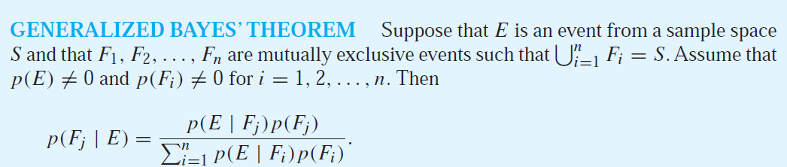
Bayes’ Theorem (2)
Bayes’ rule allows unknown probabilities to be computed from known conditional probabilities, usually in the causal direction.
Applying Bayes’ rule with many pieces of evidence runs into the same scaling problems as does the full joint distribution.
Conditional independence brought about by direct causal relationships in the domain might allow the full joint distribution to be factored into smaller, conditional distributions.
The naive Bayes model assumes the conditional independence of all effect variables, given a single cause variable, and grows linearly with the number of effects.

Slide 21
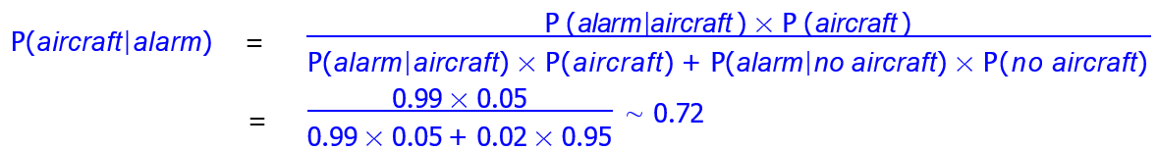
Bayes’ Theorem (3)
Q.13. A radar is designed to detect aircraft. If an aircraft is present, it is detected with probability 0.99. When no aircraft is present, the radar generates an alarm probability 0.02 (false alarm). We assume that an aircraft is present with probability 0.05. If the radar generates an alarm, what is the probability that an aircraft is present?
Answer: _{P(aircraft|alarm) =} P(alarm|aircraft) × P(aircraft)
P(alarm)
Since the set {aircraft, no aircraft} is a partition of Ω we have
P(alarm)= P(alarm ∩ aircraft) + P(alarm ∩ no aircraft)
= P(alarm|aircraft) × P(aircraft) + P(alarm|no aircraft) × P(no aircraft)
So, we obtain
Thus, if the radar generates an alarm, the probability that an aircraft is present is 0.72 i.e.72%.

Slide 22
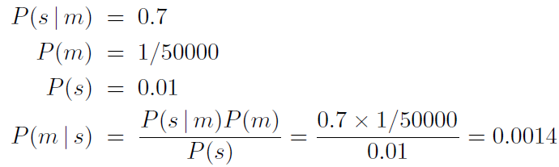
Bayes’ Theorem (4)
Q.14. A doctor knows that the disease meningitis causes the patient to have a stiff neck, say, 70% of the time. The doctor also knows some unconditional facts: the prior probability that a patient has meningitis is 1/50,000, and the prior probability that any patient has a stiff neck is 1%. What is the probability of patients with a stiff neck to have meningitis?
Answer: Letting s be the proposition that the patient has a stiff neck and m be the proposition that the patient has meningitis, we have
Less than 1 in 700 patients with a stiff neck to have meningitis.
Notice that even though a stiff neck is quite strongly indicated by meningitis (with probability 0.7), the probability of meningitis in the patient remains small. This is because the prior probability of stiff necks is much higher than that of meningitis.

Slide 23
Bayes’ Theorem (5)
Q.15. An insurance company insured 2000 scooter drivers, 4000 car drivers, and 6000 truck drivers. The probability of an accident involving a scooter driver, car driver, and a truck is 0.01, 0.03, and 0.015 respectively. One of the insured persons meets with an accident. What is the probability that he is a scooter driver?
Answer: Let S, C, T, and A be the events defined as follows:
S = person chosen is a scooter driver. P (S)= 2000/12000 =1/6
C = person chosen is a car driver. P (C)= 4000/12000 =1/3
T = person chosen is a truck driver. P (T)= 6000/12000 =1/2
A = person meets with an accident.
The total number of persons insured= 2000 + 4000 + 6000 = 12000
The probability of an accident involving a scooter driver = P(A|S) = 0.01 = 1/100
The probability of an accident involving a car driver = P(A|C) = 0.03 = 3/100
The probability of an accident involving a truck driver = P(A|T) = 0.015 = 3/20
We need to find the probability of a scooter driver provided that he is an insured person who meets with an accident P(S|A).

Slide 24
Bayes’ Theorem (6)
Q.15. cont..
Answer: By applying a generalized Bayes’ Theorem:
_{P(S|A) =} ^{P(A|S) x P(S)}
P(A|S) x P(S) + P(A|C) x P(C) + P(A|T) x P(T)
_{P(S|A) =} ^{(1/100) x (1/6)}
(1/100) x (1/6) + (3/100) x (1/3) + (3/20) x (1/2)
P(S|A) = 1/52 is the probability of a scooter driver provided that he is an insured person who meets with an accident

Slide 25
Bayes’ Theorem (7)
Q.16. Suppose that we have found that the word “Rolex” occurs in 250 of 2000 messages known to be spam and in 5 of 1000 messages known not to be spam. Estimate the probability that an incoming message containing the word “Rolex” is spam, assuming that it is equally likely that an incoming message is spam or not spam. If our threshold for rejecting a message as spam is 0.9, will we reject such messages?
Answer: We use the counts that the word “Rolex” appears in spam messages and messages that are not spam to find that P(Rolex|Spam) = 250/2000 = 0.125 and P(Rolex|NonSpam) = 5/1000 = 0.005.
As the message is equally likely to be spam as it is not to be spam, P(Spam) = P(NonSpam) = 1/2
We can estimate the probability that an incoming message containing the word “Rolex” is spam by
_{P(Spam|Rolex) =} ^{P(Rolex|Spam) x P (Spam)}
P(Rolex|Spam) x P(Spam) + P(Rolex|NonSpam) x P(Non-Spam)
_{P(Spam|Rolex) =} ^{(0.125) x (0.5)}
(0.125) x (0.5) + (0.005) x (0.5)
P(Spam|Rolex) = 0.125/0.130 ≈ 0.962 is the probability of an incoming message containing the word “Rolex” is spam.
As it is greater than the threshold of spam rejection i.e. 0.9, the incoming message with a word “Rolex” will be rejected.

Slide 26
Bayesian Nets
Sources:
Stuart Russell & Peter Norvig, "Artificial Intelligence : A Modern Approach", Pearson Education, 2nd Edition.
Kenneth Rosen, Discrete Mathematics and its Applications, Tata McGraw Hill Publication, 7th edition, ISBN 978-0-07-338309-5
Edward A. Bender, Mathematical Methods in Artificial Intelligence, IEEE Computer Society Press Los Alamitos, California, ISBN: 9780818672002, 9780818672002.
Elaine Rich and Kevin Knight, "Artificial Intelligence" Tata McGraw Hill.

Slide 27
Bayesian Nets (1)
Bayesian networks are graphs that are perfectly equipped to deal with uncertainty, encoding probabilities in a mathematically sound way.
A Bayesian network is a probabilistic graphical model which represents a set of variables and their conditional dependencies using a directed acyclic graph in which each node is annotated with quantitative probability information.
Bayesian networks may also be referred to as causal networks, as belief networks, as probabilistic networks, or as knowledge maps.
Representation of causal relations in Bayesian networks makes the representation and inference efficient.
The full specification is as follows:
Each node corresponds to a random variable, which may be discrete or continuous.
A set of directed links or arrows connects pairs of nodes. If there is an arrow from node X to node Y , X is said to be a parent of Y. The graph has no directed cycles and hence is a directed acyclic graph, or DAG.
Each node Xi has a conditional probability distribution P(Xi | Parents(Xi)) that quantifies the effect of the parents on the node.

Slide 28
Bayesian Nets (2)
In a Bayesian network:
The nodes are variables that we believe our model should include.
The edges are directed, pointing from the parent node to the child node, or from a higher neuron to a lower neuron, in the sense that we know the probability of the child variable is conditional on observing the parent variable.
No cycles are allowed in the graph of the network.
Heavy reliance on Bayes’ Rule: if there is an arrow from A to B, then P(B|A) is the forward probability, and P(A|B) is the inverse probability.
Think of this as P(evidence|hypothesis) or P(symptoms|disease). We can calculate the inverse probability from Bayes’ Rule:
If there is no arrow pointing to a variable (if it has no parents), then all we need is the prior probability of that variable, which we compute from the data or from expert knowledge.
If we happen to obtain more data on one of the variables in the model, or more evidence, we update the node corresponding to that variable (the conditional probability), then propagate that information following the connections in the network, updating the conditional probabilities at each node, in two different ways, depending on whether the information is propagating from parent to child, or from child to parent. The update in each direction is very simple: comply with Bayes’ Rule.
P(A|B) = ^{P(B|A)x P(A)} ; if P(B) ≠ 0
^{P(B)}

Slide 29
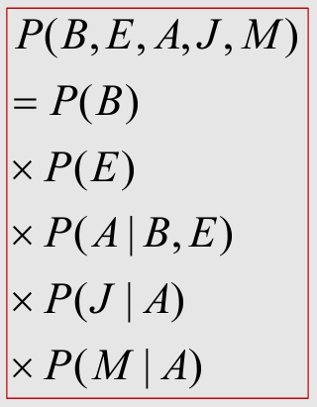
Bayesian Nets (3)
Example:
You have a new burglar alarm installed at home. It is fairly reliable at detecting a burglary, but also responds on occasion to minor earthquakes.
You also have two neighbors, John and Mary, who have promised to call you at work when they hear the alarm.
John nearly always calls when he hears the alarm, but sometimes confuses the telephone ringing with the alarm and calls then, too.
Mary, on the other hand, likes rather loud music and often misses the alarm altogether.
Given the evidence of who has or has not called, we would like to estimate the probability of a burglary.

Slide 30
Bayesian Nets (4)
A Bayesian network for this domain appears in Figure 14.2. The network structure shows that burglary and earthquakes directly affect the probability of the alarm’s going off, but whether John and Mary call depends only on the alarm. The network thus represents our assumptions that they do not perceive burglaries directly, they do not notice minor earthquakes, and they do not confer before calling.
The conditional distributions in Figure 14.2 are shown as a conditional probability table, or CPT.
Each row in a CPT contains the conditional probability of each node value for a conditioning case. A conditioning case is just a possible combination of values for the parent nodes. Each row must sum to 1, because the entries represent an exhaustive set of cases for the variable.
For Boolean variables, once you know that the probability of a true value is p, the probability of false must be 1 – p, so we often omit the second number, as in Figure 14.2.
In general, a table for a Boolean variable with k Boolean parents contains 2^{k} independently specifiable probabilities.
A node with no parents has only one row, representing the prior probabilities of each possible value of the variable.

Slide 31
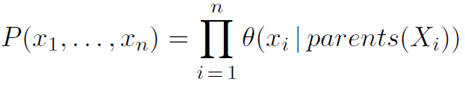
Bayesian Nets (5)
Semantics of Baysian Net:
There are two ways in which one can understand the semantics of Bayesian networks.
The first is to see the network as a representation of the joint probability distribution. It is helpful in understanding how to construct networks.
The second is to view it as an encoding of a collection of conditional independence statements. It is helpful in designing inference procedures.
As a piece of “syntax,” a Bayesian network is a directed acyclic graph with some numeric parameters attached to each node.
Those parameters correspond to conditional probabilities P(X_{i} | Parents(X_{i})); this is a true statement, but until we assign semantics to the network as a whole, we should think of them just as numbers θ(Xi | Parents(Xi)).
A generic entry in the joint distribution is the probability of a conjunction of particular assignments to each variable, such as P(X₁ =x₁ ∧ . . . ∧ X_{n} = x_{n}). We use the notation P(x₁, . . . , x_{n}) as an abbreviation for this. The value of this entry is given by the formula
…….(1)
where parents(X_{i}) denotes the values of Parents(X_{i}) that appear in x₁, . . . , x_{n}. Thus, each entry in the joint distribution is represented by the product of the appropriate elements of the conditional probability tables (CPTs) in the Bayesian network.

Slide 32
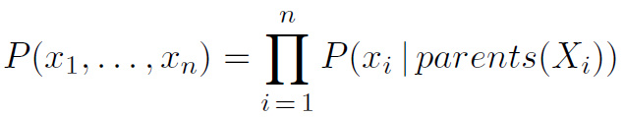
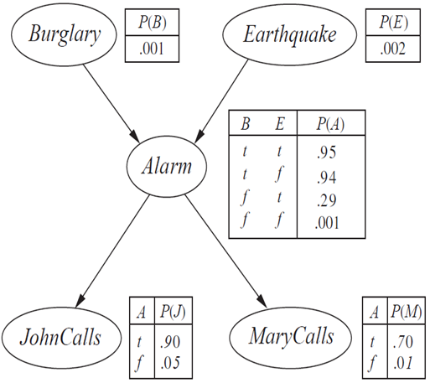
Bayesian Nets (6)
Semantics of Baysian Net:
From this definition, it is easy to prove that the parameters θ(Xi | Parents(Xi)) are exactly the conditional probabilities P(Xi | Parents(Xi)). implied by the joint distribution. Hence, we can rewrite Equation (1) as
…………..(2)
In other words, the tables we have been calling conditional probability tables really are conditional probability tables according to the semantics defined in Equation (1).
To illustrate this, we can calculate the probability that the alarm has sounded, but neither a burglary nor an earthquake has occurred, and both John and Mary call. We multiply entries from the joint distribution (using single-letter names for the variables):
P(j, m, a,￢b,￢e) = P(j | a)P(m| a)P(a | ￢b ∧ ￢e)P(￢b)P(￢e)
= 0.90 × 0.70 × 0.001 × 0.999 × 0.998 = 0.000628.
If a Bayesian network is a representation of the joint distribution,
then it too can be used to answer any query, by summing all the
relevant joint entries.

Slide 33
Bayesian Nets (7)
A method for constructing Bayesian networks:
The specification of the joint distribution is equivalent to the general assertion that, for every variable X_{i} in the network,
P(X_{i} |X_{i−1}, . . . ,X₁) = P(X_{i} | Parents(X_{i})) …….(3)
provided that Parents(X_{i}) ⊆ {X_{i−1}, . . . ,X₁}. This last condition is satisfied by numbering the nodes in a way
that is consistent with the partial order implicit in the graph structure.
We can satisfy this condition with this methodology:
Nodes: First determine the set of variables that are required to model the domain. Now order them, {X₁, . . . ,X_{n}}. Any order will work, but the resulting network will be more compact if the variables are ordered such that causes precede effects.
Links: For i = 1 to n do:
Choose, from X₁, . . . ,X_{i−1}, a minimal set of parents for X_{i}, such that Equation (3) is satisfied.
For each parent insert a link from the parent to X_{i}.
CPTs: Write down the conditional probability table, P(X_{i} | Parents(X_{i})).
Intuitively, the parents of node X_{i} should contain all those nodes in X₁, . . . ,X_{i−1} that directly influence X_{i}.

Slide 34
Bayesian Nets (8)
Considering Burglary alarm example in Figure 14.2 formally speaking, we believe that the following conditional independence statement holds:
P(MaryCalls | JohnCalls ,Alarm,Earthquake,Burglary) = P(MaryCalls |Alarm)
Thus, Alarm will be the only parent node for MaryCalls.
Because each node is connected only to earlier nodes, this construction method guarantees that the network is acyclic.
Another important property of Bayesian networks is that they contain no redundant probability values. If there is no redundancy, then there is no chance for inconsistency: it is impossible for the knowledge engineer or domain expert to create a Bayesian network that violates the axioms of probability.
A Bayesian network can often be far more compact than the full joint distribution. This property is what makes it feasible to handle domains with many variables.
The compactness of Bayesian networks is an example of a general property of locally structured (also called sparse) systems. In a locally structured system, each subcomponent interacts directly with only a bounded number of other components, regardless of the total number of components. Local structure is usually associated with linear rather than exponential growth in complexity.

Slide 35
Bayesian Nets (9)
Examples:
A
B
C
Marginal Independence:
p(A,B,C) = p(A) p(B) p(C)
A: D
Conditionally independent effects:
p(A,B,C) = p(B|A)p(C|A)p(A)
B and C are conditionally independent Given A
B: S1
C: S2
A: Traffic
B: Late wakeup
Independent Causes:
p(A,B,C) = p(C|A,B)p(A)p(B)
C: late
A
B
C
Markov dependence:
p(A,B,C) = p(C|B) p(B|A)p(A)

Slide 36

Bayesian Nets (10)
Inference by Bayes’ Rule:
The basic task for any probabilistic inference system is to compute the posterior probability distribution for a set of query variables, given some observed event—that is, some assignment of values to a set of evidence variables.
We can extract a general inference procedure. We begin with the case in which the query involves a single variable, X. Let E be the list of evidence variables, let e be the list of observed values for them, and let Y be the remaining unobserved (hidden) variables. The query is P(X | e) and can be evaluated as
………….(4)
where the summation is over all possible ys (i.e., all possible combinations of values of the unobserved
variables Y) and is α a normalization constant.
Notice that together the variables X, E, and Y constitute the complete set of variables for the domain, so P(X, e, y) is simply a subset of probabilities from the full joint distribution.
Given the full joint distribution to work with, Equation (4) can answer probabilistic queries for discrete variables.

Slide 37


Bayesian Nets (9)
Inference by Enumeration in Bayesian Nets:
Any conditional probability can be computed by summing terms from the full joint distribution as described in Equation (4).
……(4)
A Bayesian network gives a complete representation of the full joint distribution as given by Equation (2).
A query can be answered using a Bayesian network by computing sums of products of conditional probabilities from the network.
Consider the query P(Burglary | JohnCalls =true, MaryCalls =true) i.e. “probability the house is being burglarized given that John and Mary both called”. The hidden variables for this query are Earthquake and Alarm.
From Equation (4), using initial letters for the variables to shorten the expressions, we have:
The semantics of Bayesian networks (Equation (2)) then gives us an expression in terms of CPT entries. For simplicity, we do this just for Burglary =true:
…..(5)

Slide 38
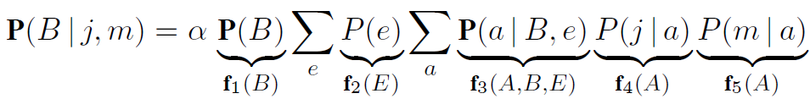

Bayesian Nets (11)
Inference by Enumeration in Bayesian Nets: (cont..)
f₃(A,B,E) consists of 8 values as below:
f₂(E) =$\left({P(\text{e}) \atop P(\text{¬}\text{e})}\right)$ = $\left({0.002 \atop 0.998}\right)$ f₁(B) =$\left({P(\text{b}) \atop P(\text{¬}\text{b})}\right)$ = $\left({0.001 \atop 0.999}\right)$
f₃(A,B,E) with b = true | f₃(A,B,E) with b = false
P(a| b, e) = 0.95 | P(a|¬b, e) = 0.29
P(¬ a| b, e) = (1 − 0.95) = 0.05 | P(¬ a| ¬b, e) = (1 − 0.29) = 0.71
P(a| b, ¬ e) = 0.94 | P(a| ¬b, ¬e) = 0.001
P(¬ a| b, ¬e) = (1 − 0.94) = 0.06 | P(¬ a| ¬b, ¬e) = (1 − 0.001) = 0.999

Slide 39
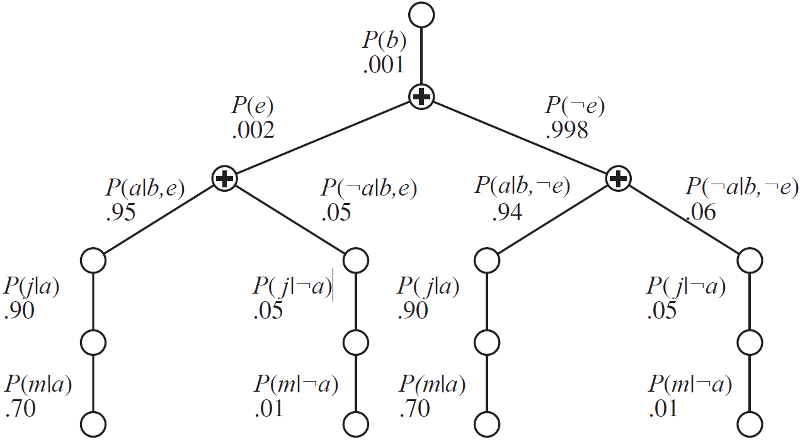
Bayesian Nets (12)
Inference by Bayes’ Rule: (cont..)
The expression (5) can be evaluated by looping through the variables in order, multiplying CPT entries as we go.

Slide 40
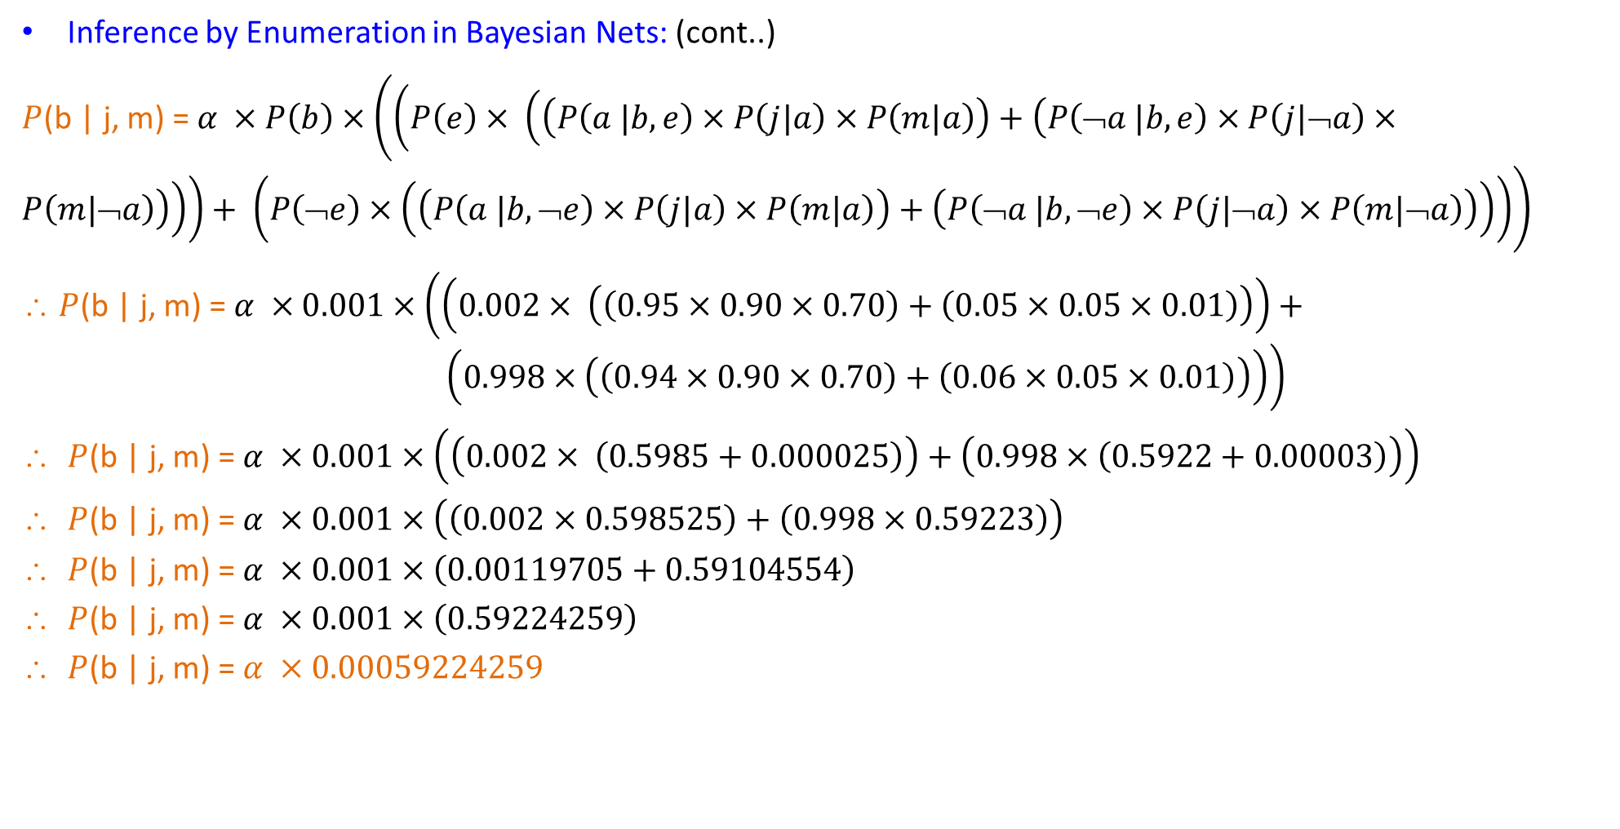
Bayesian Nets (13)
Inference by Enumeration in Bayesian Nets: (cont..)
$P$(b | j, m) = $α ×P\left(b\right)×\left(\left(P\left(e\right)× \left(\left(P\left(a |b,e\right)×P\left(j|a\right)×P\left(m|a\right)\right)+\left(P\left(\text{➢}a |b,e\right)×P\left(j|\text{➢}a\right)×P\left(m|\text{➢}a\right)\right)\right)\right)+ \left(P\left(\text{➢}e\right)×\left(\left(P\left(a |b,\text{➢}e\right)×P\left(j|a\right)×P\left(m|a\right)\right)+\left(P\left(\text{➢}a |b,\text{➢}e\right)×P\left(j|\text{➢}a\right)×P\left(m|\text{➢}a\right)\right)\right)\right)\right)$
∴ $P$(b | j, m) = $α ×0.001×\left(\left(0.002× \left(\left(0.95×0.90×0.70\right)+\left(0.05×0.05×0.01\right)\right)\right)+ \left(0.998×\left(\left(0.94×0.90×0.70\right)+\left(0.06×0.05×0.01\right)\right)\right)\right)$
$P$(b | j, m) = $α ×0.001×\left(\left(0.002× \left(0.5985+0.000025\right)\right)+\left(0.998×\left(0.5922+0.00003\right)\right)\right)$
$P$(b | j, m) = $α ×0.001×\left(\left(0.002×0.598525\right)+\left(0.998×0.59223\right)\right)$
$P$(b | j, m) = $α ×0.001×\left(0.00119705+0.59104554\right)$
$P$(b | j, m) = $α ×0.001×\left(0.59224259\right)$
$P$(b | j, m) = $α ×$ $0.00059224259$

Slide 41
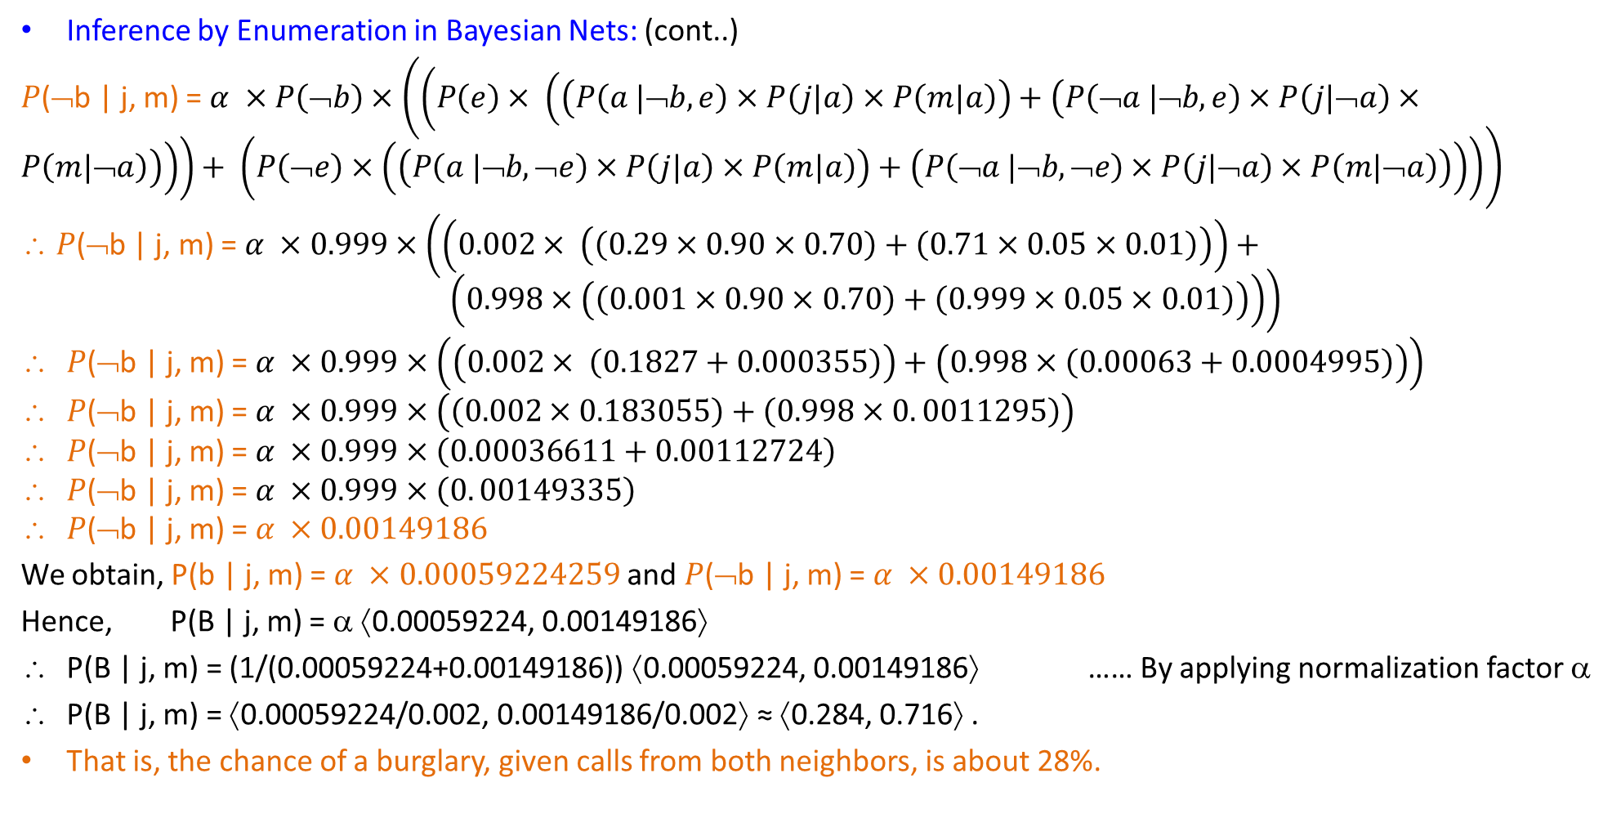
Bayesian Nets (14)
Inference by Enumeration in Bayesian Nets: (cont..)
$P$($\text{➢}$b | j, m) = $α ×P\left(\text{➢}b\right)×\left(\left(P\left(e\right)× \left(\left(P\left(a |\text{➢}b,e\right)×P\left(j|a\right)×P\left(m|a\right)\right)+\left(P\left(\text{➢}a |\text{➢}b,e\right)×P\left(j|\text{➢}a\right)×P\left(m|\text{➢}a\right)\right)\right)\right)+ \left(P\left(\text{➢}e\right)×\left(\left(P\left(a |\text{➢}b,\text{➢}e\right)×P\left(j|a\right)×P\left(m|a\right)\right)+\left(P\left(\text{➢}a |\text{➢}b,\text{➢}e\right)×P\left(j|\text{➢}a\right)×P\left(m|\text{➢}a\right)\right)\right)\right)\right)$
∴ $P$($\text{➢}$b | j, m) = $α ×0.999×\left(\left(0.002× \left(\left(0.29×0.90×0.70\right)+\left(0.71×0.05×0.01\right)\right)\right)+ \left(0.998×\left(\left(0.001×0.90×0.70\right)+\left(0.999×0.05×0.01\right)\right)\right)\right)$
$P$($\text{➢}$b | j, m) = $α ×0.999×\left(\left(0.002× \left(0.1827+0.000355\right)\right)+\left(0.998×\left(0.00063+0.0004995\right)\right)\right)$
$P$($\text{➢}$b | j, m) = $α ×0.999×\left(\left(0.002×0.183055\right)+\left(0.998×0. 0011295\right)\right)$
$P$($\text{➢}$b | j, m) = $α ×0.999×\left(0.00036611+0.00112724\right)$
$P$($\text{➢}$b | j, m) = $α ×0.999×\left(0. 00149335\right)$
$P$($\text{➢}$b | j, m) = $α ×0.00149186$
We obtain, P(b | j, m) = $α ×$ $0.00059224259$ and $P$($\text{➢}$b | j, m) = $α ×0.00149186$
Hence, P(B | j, m) = α ⟨0.00059224, 0.00149186⟩
P(B | j, m) = (1/(0.00059224+0.00149186)) ⟨0.00059224, 0.00149186⟩ …… By applying normalization factor α
P(B | j, m) = ⟨0.00059224/0.002, 0.00149186/0.002⟩ ≈ ⟨0.284, 0.716⟩ .
That is, the chance of a burglary, given calls from both neighbors, is about 28%.

Slide 42

Bayesian Nets (15)
Q.17. Consider the following Bayesian Net. F= Having Flu and C=Coughing.
Write down the joint probability table specified by the Bayesian network.
Find P(C).
Determine the probabilities for the following Bayesian network so that it specifies the same joint probabilities as the given one.
Answer: a) The joint probability table specified by the Bayesian network:
F | C | Joint Probabilities
t | t | P(F) × P(C|F) = 0.2 × 0.9 = 0.18
t | f | P(F) × P(¬ C|F) = 0.2 × (1− 0.9) = 0.2 × 0.1 = 0.02
f | t | P(¬ F) × P(C|¬ F) = (1 − 0.2) × 0.3 = 0.8 × 0.3 = 0.24
f | f | P(¬ F) × P(¬C|¬ F) = (1 − 0.2) × (1 − 0.3) = 0.8 × 0.7 = 0.56

Slide 43
Bayesian Nets (16)
Q.17. cont..
Answer: b) P(C) = P(C|F) × P(F) + P(C|¬ F) × P(¬ F)
= 0.9 × 0.2 + 0.3 × (1 − 0.2)
= 0.18 + 0.24 = 0.42
c) The probabilities of the following Bayesian network so that it specifies the same joint probabilities as the given one:
P(C) = 0.18 + 0.24 = 0.42
P(F|C) = P(F, C) / P(C) = 0.18/0.42 = 0.23
P(F|¬ C) = P(F, ¬ C) / P(¬ C) = 0.02/(1 − 0.42) = 0.02/0.58 = 0.035

Slide 44
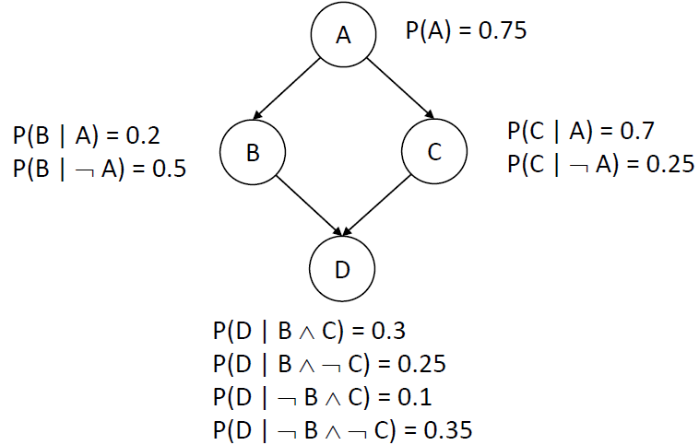
Bayesian Nets (17)
Q.18. Consider the following Bayesian network. A, B, C, and D are Boolean random variables. If we know that A is true, what is the probability of D being true?
Answer:
P(D|A) = P(A, D) / P(A)
= (P(A, B, C, D) + P(A, B, ¬ C, D) + P(A, ¬ B, C, D) + P(A, ¬ B, ¬ C, D)) / P(A)
= P(B|A) P(C | A) P(D | B, C) + P(B | A) P(¬ C | A) P(D | B, ¬ C) + P(¬ B | A) P(C | A) P(D | ¬ B, C) +
P(¬ B | A) P(¬ C |A) P(D | ¬ B, ¬ C)
= (0.2 × 0.7 × 0.3) + (0.2 × 0.3 × 0.25) + (0.8 × 0.7 × 0.1) + (0.8 × 0.3 × 0.35)
= 0.042 + 0.015 + 0.056 + 0.084
= 0.197

Slide 45
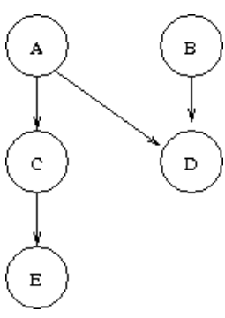
Bayesian Nets (18)
Q.19. Consider the following Bayesian network.
P(A) = 0.3; P(B) = 0.6; P(C| A) = 0.8; P(C| ¬ A) = 0.4; P(D| A, B) = 0.7; P(D| A, ¬ B) = 0.8; P(D| ¬ A, B) = 0.1; P(D| ¬ A, ¬ B) = 0.2; P(E| C) = 0.7 P(E| ¬ C) = 0.2
Compute 1) P(D); 2) P(A|C) 3) P(A| ¬ D)
Answer:
1) P(D) = P(D, A, B) + P(D, A, ¬ B) + P(D, ¬ A, B) + P(D, ¬ A, ¬ B)
= P(D|A, B) P(A, B) + P(D|A, ¬ B) P(A, ¬ B) + P(D| ¬ A, B) P(¬ A, B) + P(D| ¬ A, ¬ B) P(¬ A, ¬ B)
(since A and B are independent absolutely)
= P(D|A, B) P(A) P(B) + P(D|A, ¬ B) P(A) P(¬ B) + P(D| ¬ A, B) P(¬ A) P(B) + P(D| ¬ A, ¬ B) P(¬ A) P(¬ B) = 0.7 × 0.3 × 0.6 + 0.8 × 0.3 × 0.4 + 0.1 × 0.7 × 0.6 + 0.2 × 0.7 × 0.4 = 0.32

Slide 46
Bayesian Nets (18)
Q.19. cont...
Answer: 2) P(A|C) = P(C|A)P(A) / P(C). Now P(C) = P(C, A) + P(C, ¬ A)
= P(C|A) P(A) + P(C| ¬ A) P(¬ A)
= P(C|A) P(A) + P(C| ¬ A) (1 − P(A) )
= 0.8 × 0.3+ 0.4 × (1 − 0.3)
= 0.8 × 0.3+ 0.4 × 0.7 = 0.52
So, P(C|A) P(A) / P(C) = 0.8 × 0.3/0.52= 0.46.
3) P(A| ¬ D) = P(¬ D|A) P(A)/P(¬ D).
Now P(¬ D) = 1 − P(D) = 1 − 0.32 = 0.68 ….from the first sub question above.
P(¬ D|A) = P(D, B|A) + P(¬ D, ¬ B|A)
= P(¬ D|B, A) P(B|A) + P(¬ D| ¬ B, A) P(¬ B|A) (since B is independent of A)
= P(¬ D|B, A) P(B) + P(¬ D| ¬ B, A) P(¬ B)
= (1 − P( D|B, A) ) P(B) + (1 − P(D| ¬ B, A) ) (1 − P(B) )
= (1 − 0.7) × 0.6 + (1 − 0.8) × (1 − 0.6)
= 0.3 × 0.6 + 0.2 × 0.4 = 0.26.
So, P(A| ¬ D) = P(¬ D|A) P(A)/P(¬ D) = 0.26 × 0.3 / 0.68 = 0.115

Slide 47
Bayesian Nets (19)
Noisy-OR Relationship:
Uncertain relationships can often be characterized by so-called noisy logical relationships. The standard example is the noisy-OR relation, which is a generalization of the logical OR.
In propositional logic, we might say that Fever is true if and only if Cold, Flu, or Malaria is true. The noisy-OR model allows for uncertainty about the ability of each parent to cause the child to be true—the causal relationship between parent and child may be inhibited, and so a patient could have a cold, but not exhibit a fever.
The model makes two assumptions.
First, it assumes that all the possible causes are listed. (If some are missing, we can always add a so-called leak node that covers “miscellaneous causes.”)
Second, it assumes that inhibition of each parent is independent of inhibition of any other parents: E.g., whatever inhibits Malaria from causing a fever is independent of whatever inhibits Flu from causing a fever.
Given these assumptions, Fever is false if and only if all its true parents are inhibited, and the probability of this is the product of the inhibition probabilities q for each parent.

Slide 48

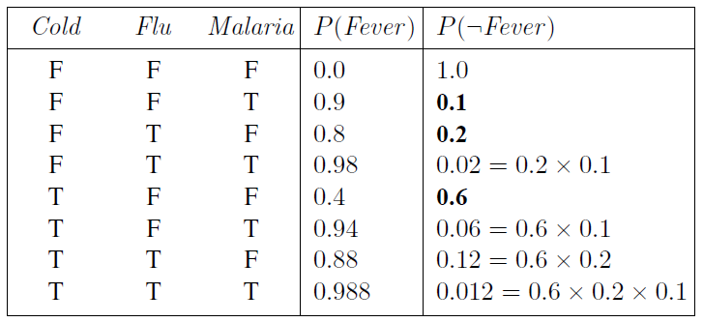
Bayesian Nets (20)
Noisy-OR Relationship: (cont..)
Let us suppose these individual inhibition probabilities are as follows:
q_{cold} = P(￢fever | cold, ￢flu, ￢malaria) = 0.6 ,
q_{flu} = P(￢fever | ￢cold, flu, ￢malaria) = 0.2 ,
q_{malaria} = P(￢fever | ￢cold,￢flu, malaria) = 0.1 .
Then, from this information and the noisy-OR assumptions, the entire CPT can be built. The general rule is that:
where the product is taken over the parents that are set to true for that row of the CPT.
The following table illustrates this calculation:
In general, noisy logical relationships in which a variable depends on k parents can be described using O(k) parameters instead of O(2^{k}) for the full conditional probability table. This makes assessment and learning much easier.

Slide 49
Directed Acyclic Graph (DAG)
Sources:
Stuart Russell & Peter Norvig, "Artificial Intelligence : A Modern Approach", Pearson Education, 2nd Edition.
Kenneth Rosen, Discrete Mathematics and its Applications, Tata McGraw Hill Publication, 7th edition, ISBN 978-0-07-338309-5
Edward A. Bender, Mathematical Methods in Artificial Intelligence, IEEE Computer Society Press Los Alamitos, California, ISBN: 9780818672002, 9780818672002.
Elaine Rich and Kevin Knight, "Artificial Intelligence" Tata McGraw Hill.

Slide 50
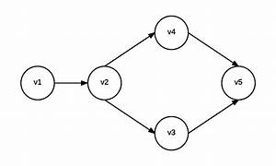
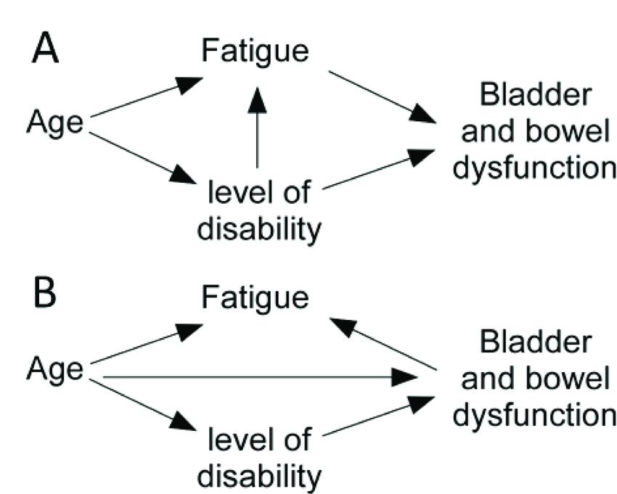
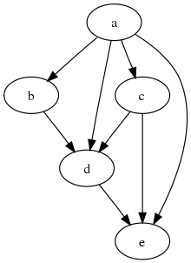
Directed Acyclic Graph (1)
In mathematics, particularly graph theory, and computer science, a directed acyclic graph (DAG) is a directed graph with no directed cycles.
That is, it consists of vertices and edges (also called arcs), with each edge directed from one vertex to another, such that following those directions will never form a closed loop.
A directed graph is a DAG if and only if it can be topologically ordered, by arranging the vertices as a linear ordering that is consistent with all edge directions.
DAGs have numerous scientific and computational applications, ranging from biology (evolution, family trees, genealogy, epidemiology) to information science (citation networks, versioning in Git) to computation (scheduling, a Merkle Tree in Blockchain, Artificial Neural Net, Deep Learning).
Directed acyclic graphs are sometimes instead called acyclic directed graphs or acyclic digraphs.

Slide 51
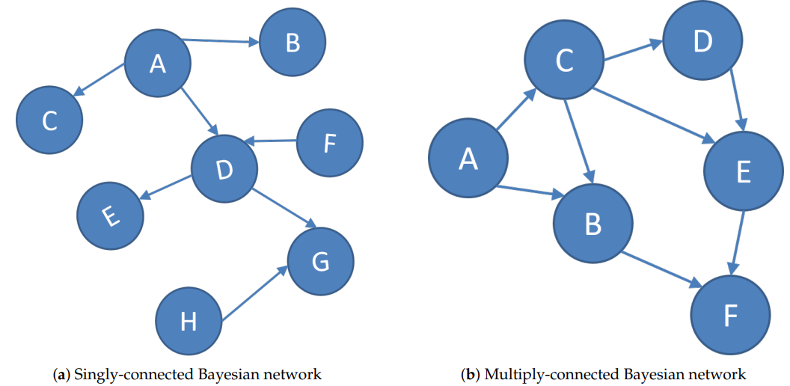
Directed Acyclic Graph (2)
Connected DAG: A DAG (V, E) is connected if, between every two vertices, there is at least one undirected path.
Singly Connected DAG: It is singly connected if, between every two vertices there is exactly one undirected path. A singly connected DAG is also called a polytree. A singly-connected Bayesian network, also known as a causal polytree.
Multiply Connected DAG: In multiply-connected networks, there could be two or more undirected paths between 2 nodes.
A graph covering of a graph G is a sub-graph of G which contains either all the vertices or all the edges corresponding to some other graph.

Slide 52
Bipartite Graphs
Sources:
Kenneth Rosen, Discrete Mathematics and its Applications, Tata McGraw Hill Publication, 7th edition, ISBN 978-0-07-338309-5
Stuart Russell & Peter Norvig, "Artificial Intelligence : A Modern Approach", Pearson Education, 2nd Edition.
Edward A. Bender, Mathematical Methods in Artificial Intelligence, IEEE Computer Society Press Los Alamitos, California, ISBN: 9780818672002, 9780818672002.
Elaine Rich and Kevin Knight, "Artificial Intelligence" Tata McGraw Hill.

Slide 53
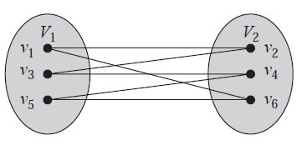
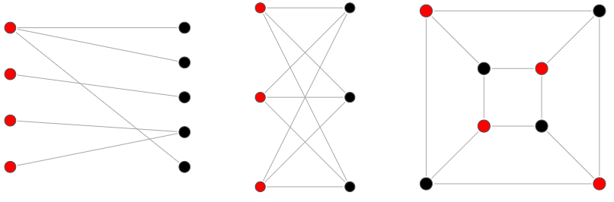
Bipartite Graphs (1)
Sometimes a graph has the property that its vertex set can be divided into two disjoint subsets such that each edge connects a vertex in one of these subsets to a vertex in the other subset.
E.g. consider the graph representing marriages between men and women in a village, where each person is represented by a vertex and a marriage is represented by an edge. In this graph, each edge connects a vertex in the subset of vertices representing males and a vertex in the subset of vertices representing females.
A Bipartite Graph: A simple graph G is called bipartite if its vertex set V can be partitioned into two disjoint sets V1 and V2 such that every edge in the graph connects a vertex in V1 and a vertex in V2 (so that no edge in G connects either two vertices in V1 or two vertices in V2). When this condition holds, we call the pair (V1, V2) a bipartition of the vertex set V of G.
Theorem: A simple graph is bipartite if and only if it is possible to assign one of two different colors to each vertex of the graph so that no two adjacent vertices are assigned the same color.

Slide 54
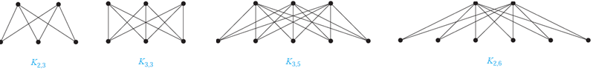
Bipartite Graphs (2)
A complete bipartite graph K_{m,n} is a graph that has its vertex set partitioned into two subsets of m and n vertices, respectively with an edge between two vertices if and only if one vertex is in the first subset and the other vertex is in the second subset. E.g., Artificial Neural Network
Bipartite graphs can be used to model many types of applications that involve matching the elements of one set to elements of another. E.g., Job assignment, marriages, Sport Matches etc.
Characteristics of bipartite graphs:
Vertices can be divided into two disjoint sets: A bipartite graph can be partitioned into two sets of vertices, with no edges between vertices within each set.
Every edge connects vertices in different sets: Every edge in a bipartite graph connects a vertex from one set to a vertex from the other set.
No odd-length cycles: A bipartite graph cannot contain any odd-length cycles, as this would require vertices from the same set to be connected by an edge.
Maximum degree is bounded by the size of the smaller set: The maximum degree of a vertex in a bipartite graph is equal to the size of the smaller set.
Coloring with two colors: A bipartite graph can be colored with two colors, such that no adjacent vertices have the same color.

Slide 55
Bipartite Graphs (3)
Bipartite Matching: A matching in a Bipartite Graph is a set of the edges chosen in such a way that no two edges share an endpoint. A maximum matching is a matching of maximum size (maximum number of edges). In a maximum matching, if any edge is added to it, it is no longer a matching. There can be more than one maximum matchings for a given Bipartite Graph.
Necessary and Sufficient Conditions for Complete Matchings:
We now turn our attention to the question of determining whether a complete matching from V1 to V2 exists when (V1, V2) is a bipartition of a bipartite graph G = (V ,E).
We will introduce a theorem that provides a set of necessary and sufficient conditions for the existence of a complete matching. This theorem was proved by Philip Hall in 1935.
Hall’s Marriage Theorem:
The bipartite graph G = (V ,E) with bipartition (V1, V2) has a complete matching from V1 to V2 if and only if |Neighbors (A)| ≥ |A| for all subsets A of V1.

Slide 56
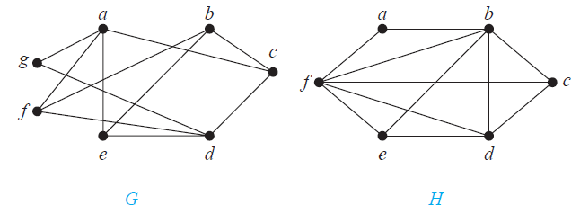
Bipartite Graphs (4)
Q.20. Are the graphs G and H displayed in Figure below bipartite?
Answer:
Graph G is bipartite because its vertex set is the union of two disjoint sets, {a, b, d} and {c, e, f, g}, and each edge connects a vertex in one of these subsets to a vertex in the other subset. (Note that for G to be bipartite it is not necessary that every vertex in {a, b, d} be adjacent to every vertex in {c, e, f, g}. For instance, b and g are not adjacent.)
Graph H is not bipartite because its vertex set cannot be partitioned into two subsets so that edges do not connect two vertices from the same subset. (The reader should verify this by considering the vertices a, b, and f.)

Slide 57
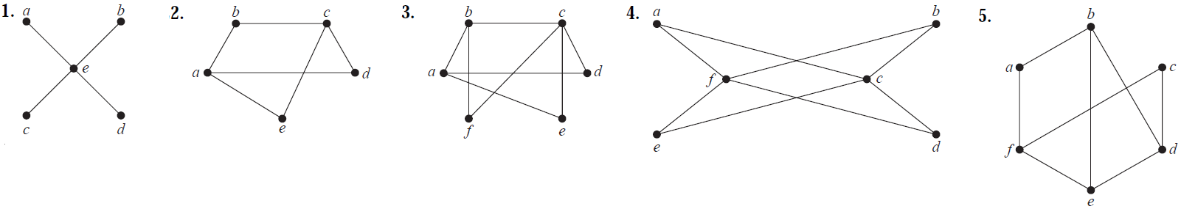
Bipartite Graphs (5)
Q.21. Determining whether it is possible to assign either red or blue to each vertex so that no two adjacent vertices are assigned the same color.
Answer:
To show that this graph is bipartite we can exhibit the parts and note that indeed every edge joins vertices in different parts. Take {e} to be one part and {a, b, c, d} to be the other (in fact there is no choice in the matter). Each edge joins a vertex in one part to a vertex in the other. This graph is the complete bipartite graph K_{1,4} and can be colored with two colors so that no two adjacent vertices are assigned the same color.
To show that this graph is bipartite we can exhibit the parts and note that indeed every edge joins vertices in different parts. Take {a, c} to be one part and {b, d, e} to be the other. Each edge joins a vertex in one part to a vertex in the other. This graph can be colored with two colors so that no two adjacent vertices are assigned the same color.

Slide 58
Bipartite Graphs (6)
Q. 21. Answer: cont..
We can show that this graph is not bipartite by the pigeonhole principle. Consider the vertices b, c, and f. They form a triangle − each is joined by an edge to the other two. By the pigeonhole principle, at least two of them must be in the same part of any proposed bipartition. Therefore, there would be an edge joining two vertices in the same part, a contradiction to the definition of a bipartite graph. Thus, this graph is not bipartite.
An alternative way to look at this is given by bipartite graph coloring theorem. Because of the triangle, it
is impossible to color the vertices to satisfy the condition given there. This graph cannot be colored with two
colors so that no two adjacent vertices are assigned the same color.
To show that this graph is bipartite we can exhibit the parts and note that indeed every edge joins vertices in different parts. Take {c, f} to be one part and {a, b, d, e} to be the other. Each edge joins a vertex in one part to a vertex in the other. This graph is the complete bipartite graph K_{2,4} and can be colored with two colors so that no two adjacent vertices are assigned the same color.
We can show that this graph is not bipartite by looking at a triangle, in this case the triangle formed by vertices b, d, and e. Each of these vertices is joined by an edge to the other two. By the pigeonhole principle, at least two of them must be in the same part of any proposed bipartition. Therefore there would be an edge joining two vertices in the same part, a contradiction to the definition of a bipartite graph. Thus, this graph is not bipartite and hence, cannot be colored with two colors so that no two adjacent vertices are assigned the same color.

Slide 59
Bipartite Graphs (7)
Q.22. Suppose that there are four employees in the computer support group of the School of Engineering of a large university. Each employee will be assigned to support one of four different areas: hardware, software, networking, and wireless. Suppose that Pawan is qualified to support hardware, networking, and wireless; Mohan is qualified to support software and networking; Ram is qualified to support networking and wireless, and Shyam is qualified to support hardware and software.
Use a bipartite graph to model the four employees and their qualifications.
Use Hall’s theorem to determine whether there is an assignment of employees to support areas so that each employee is assigned one area to support.
If an assignment of employees to support areas so that each employee is assigned to one support area exists, find one.
Answer:
The bipartite graph has vertices h, s, n, and w representing the support areas and P, M, R, and S representing the employees. The qualifications are modeled by the bipartite graph with edges Ph, Pn, Pw, Ms, Mn, Rn, Rw, Sh, and Ss.
Since every vertex representing an area has degree at least 2, the condition in Hall's theorem is satisfied for sets of size less than 3. We can easily check that the number of employees qualified for each of the four subsets of size 3 is at least 3, and clearly the number of employees qualified for each of the subsets of size 4 has size 4.
The answer is not unique; one complete matching is {Pn, Ms, Rw, Sh}, which is easily found by inspection.

Slide 60
Bipartite Graphs (8)
Q.23. Suppose that there are five young women and five young men on an island. Each man is willing to marry some of the women on the island and each woman is willing to marry any man who is willing to marry her. Suppose that Sandeep is willing to marry Tina and Vandana; Barry is willing to marry Tina, Xia, and Uma; John is willing to marry Tina and Zelda; Anil is willing to marry Vandana and Zelda; and Emilio is willing to marry Tina and Zelda. Use Hall’s theorem to show there is no matching of the young men and young women on the island such that each young man is matched with a young woman he is willing to marry.
Answer:
The partite sets are the set of women ({Tina, Uma, Vandana, Xia, Zelda}) and the set of men ( { Anil, Barry, Emilio, Sandeep, John} ).
We will use first letters for convenience.
The given information tells us that we have edges AV, AZ, BT, BX, BU, ET, EZ, JT, JZ, ST, and SV in our graph.
We do not put an edge between a man and a woman he is not willing to marry.
By inspection we find that the condition in Hall's theorem is violated by {U, X}, because these two vertices are adjacent only to B.
In other words, only Barry is willing to marry Uma and Xia, so there can be no matching.

Slide 61
Bipartite Graphs (9)
Q.24. Suppose there is an integer k such that every man on a desert island is willing to marry exactly k of the women on the island and every woman on the island is willing to marry exactly k of the men. Also, suppose that a man is willing to marry a woman if and only if she is willing to marry him. Show that it is possible to match the men and women on the island so that everyone is matched with someone that they are willing to marry.
Answer:
We model this with an undirected bipartite graph, with the men and the women represented by the vertices in
the two parts and an edge between two vertices if they are willing to marry each other.
By Hall's theorem, it is enough to show that for every set S of women, the set N(S) of men willing to marry them has cardinality at least |S|.
A clever way to prove this is by counting edges. Let m be the number of edges between S and N(S). Since every vertex in S has degree k, it follows that m = k|S|.
Because these edges are incident to N(S), it follows that m ≤ k|N(S)|.
Combining these two facts gives k|S| ≤ k|N(S)|, so |N(S)| ≥ |S|, as desired.
So, it is possible to match the men and women on the island so that everyone is matched with someone that they are willing to marry.

Slide 62
Bipartite Graphs (10)
Bipartite Multiple-Diagnosis Problems:
In some situations, there may be many causes that could produce any given result; for example, in medical diagnosis many diseases could cause a particular symptom. Furthermore, there may be more than one underlying cause that is producing the observed results.
Deductive reasoning, or deduction, is making an inference based on widely accepted facts or premises. (It is General→Specific).
E.g., If a beverage is defined as "drinkable through a straw," one could use deduction to determine soup to be a beverage.
Inductive reasoning, or induction, is making an inference based on an observation, often of a sample. (It is Specific → General).
E.g., You can induce that the soup is tasty if you observe all of your friends consuming it.
Abductive reasoning, or abduction, is making a probable conclusion from what you know.
E.g., If you see an abandoned bowl of hot soup on the table, you can use abduction to conclude the owner of the soup is likely returning soon.

Slide 63
Thank you!

